Slide 1
Portfolio Demos
Kelly Appleton

Slide 2
TFTP Client and Server Group Project

Slide 3
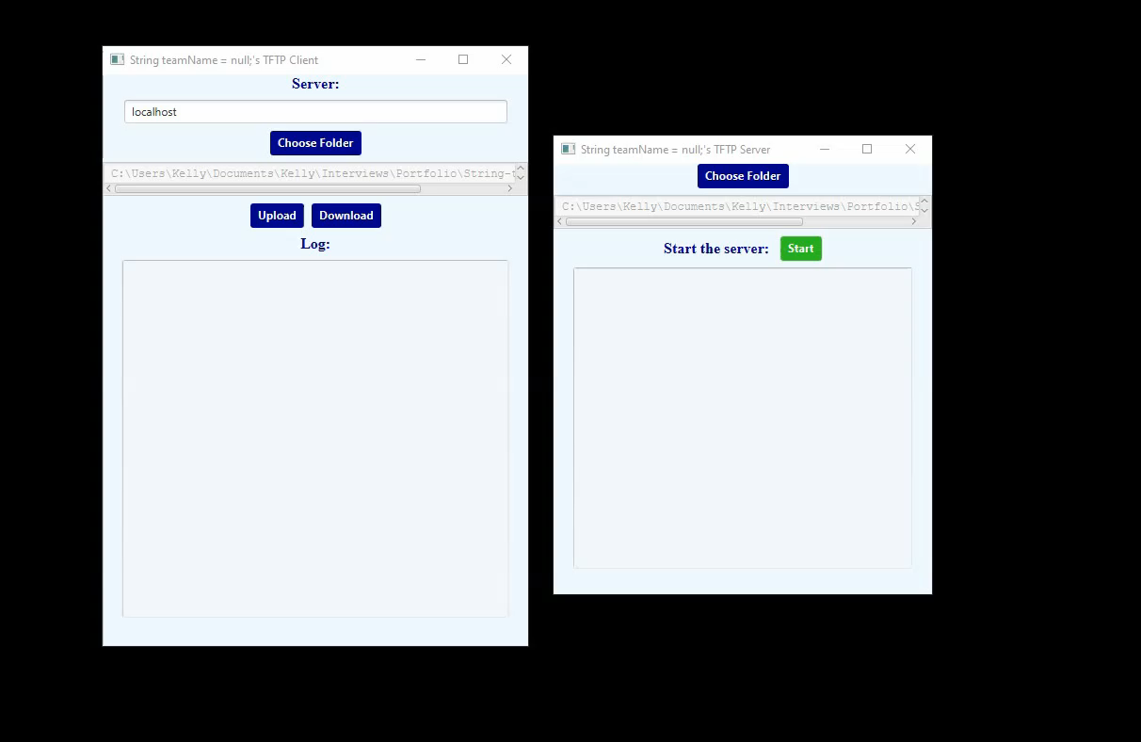

Slide 4
Team Tutorial Website

Slide 5
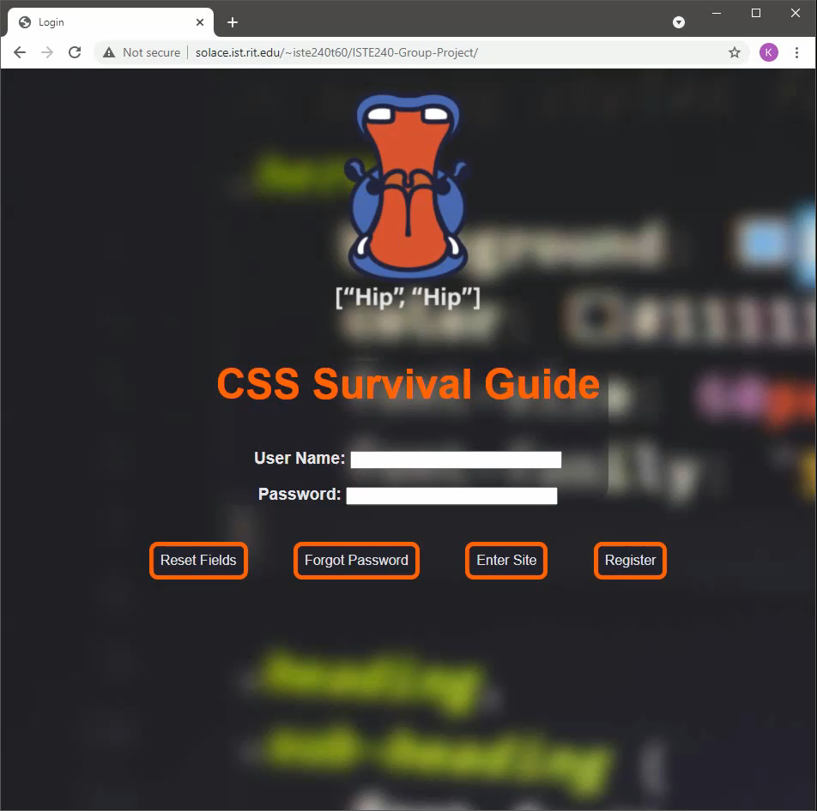

Slide 6
Travel Website

Slide 7
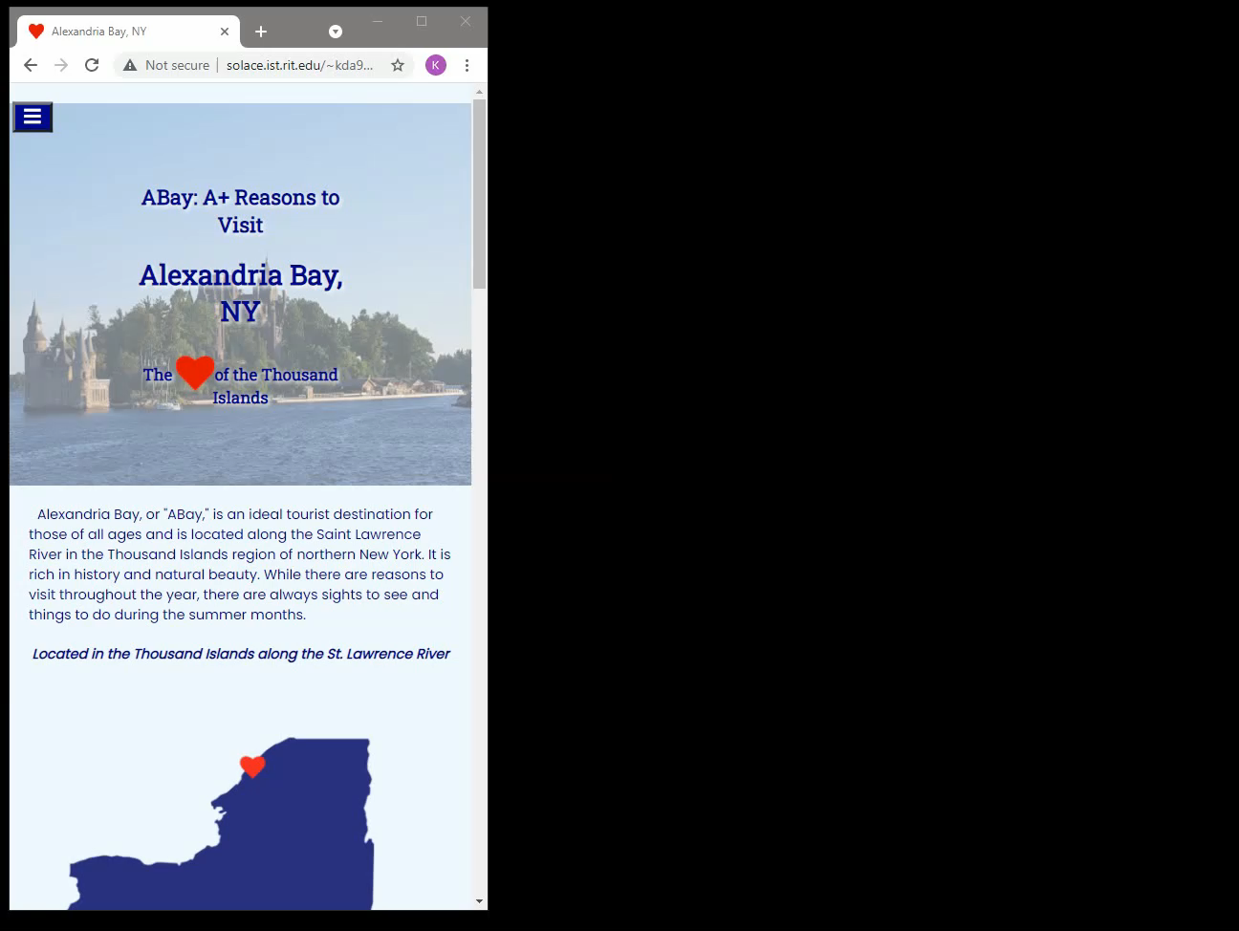

Slide 8
Composite Poster

Slide 9


Slide 10
Team Faculty Research Database

Slide 11
